Slide 1
How marketing automation can turn transactions into customer relationships

Slide 2
Agenda
The charity business model and why you should care
The value of getting the basics right with Marketing Automation
From Donation to Automation – Swedish Red Cross

Slide 3
The Charity business model
Just like donations - snow is good
When a campaign goes out it snows - but it melts so awfully fast
Turning donors into subscribers is like rolling up a snowball
Properly set up Marketing Automation can be like rolling it downhill

Slide 4
Getting the basics right
And how this impacts results…

Slide 5
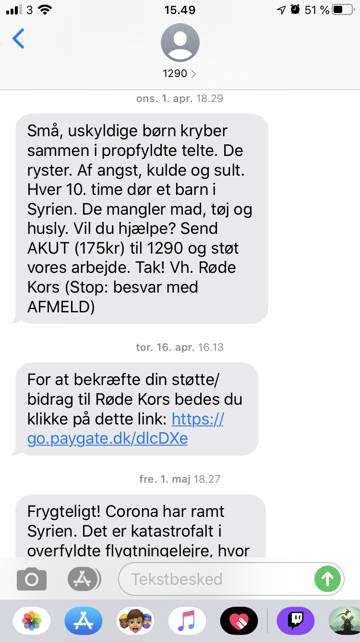
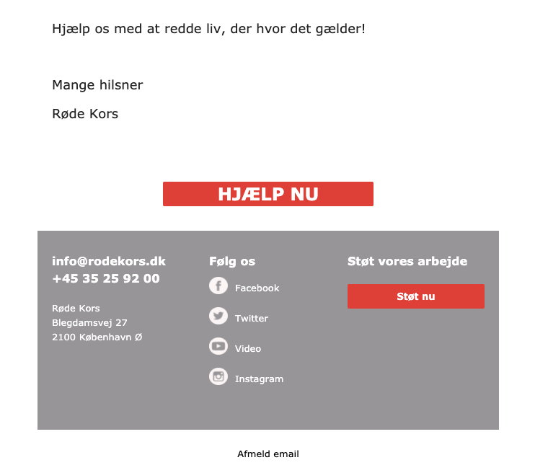
Danish Red Cross
Email revenue +120%
Emails are easy to build
Text messages are delivered lightning fast
“From we get an idea it takes us no more tan a few hours till we have an SMS and an email ready.”
Charlotte Christensen, Head of Individual Giving, Fundraising Danish Red Cross.
“Many claim easy onboarding and short time to value. But with Agillic, this is exactly what we experienced: claim and reality were a match. Of course, there were bumps on the road, but the Agillic team was very dedicated to helping us,”
Mikkel Wraae Hansen, Marketing Automation Specialist Danish Red Cross.
SMS revenue +60%

Slide 6
From Donation to Automation
Learn from Swedish Red Cross

Slide 7
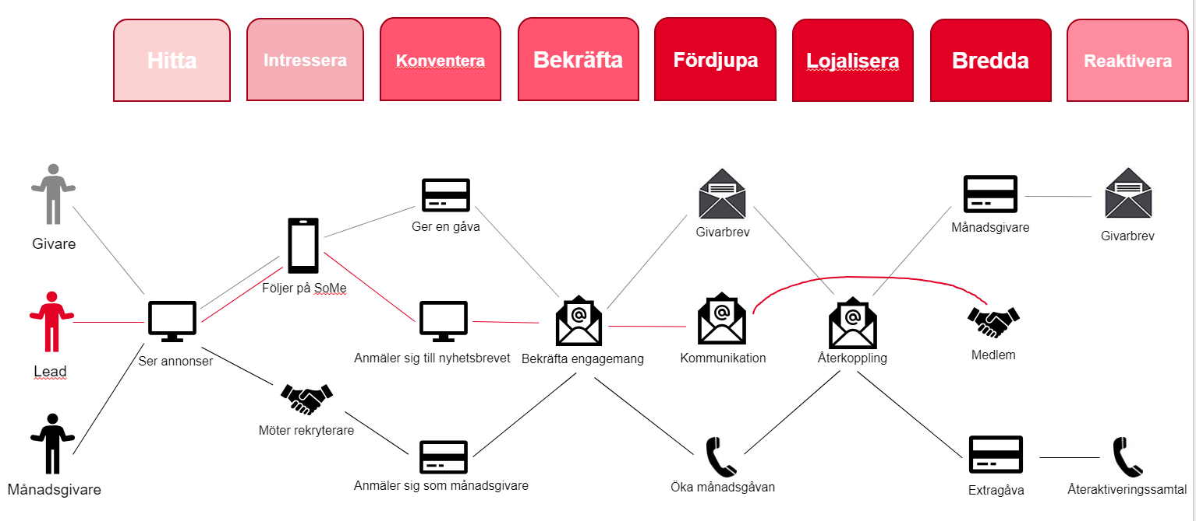
Swedish Red Cross
Notes:
- use different engagement journeys to keep the engaged both active and to increase LTV - different journeys cross on their way and one individual can be part of one or many but the MA flows keep track on which journey/message/ channel is the most prioritised at each moment. - Below is an example of a donor journey

Slide 8
Not all communication is automated Campaigns and triggers need to supplement each other
Bekräfta
Fördjupa
Lojalisera
Bredda
Reaktivera
Kampanjstyrd/Akut-kommunikation
Kundresan
Triggerstyrd
Information
Förtroendevalda
Notes:
Many different kinds of engagements
Part of local branch
Volunteer
Donor
Regular donor
Member (small yearly fee)

Slide 9
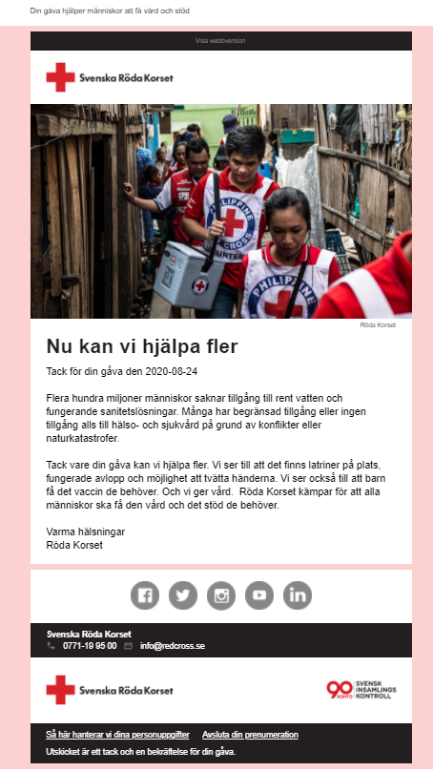
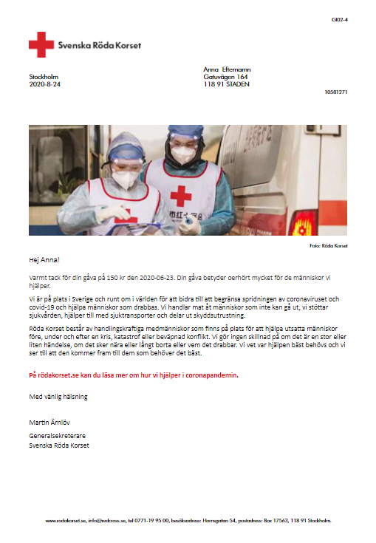
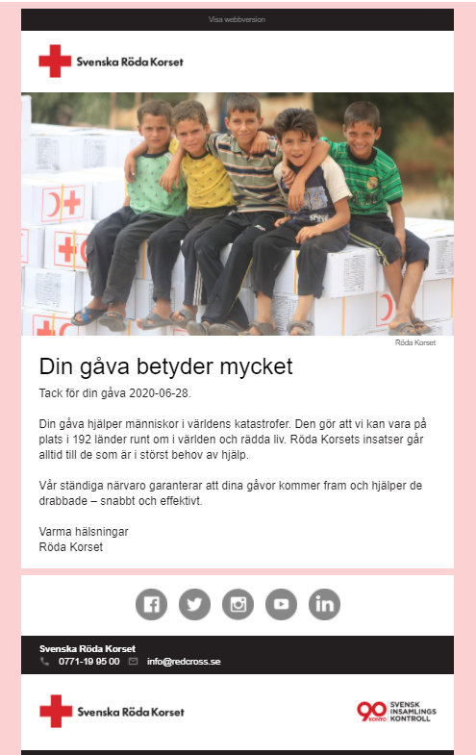
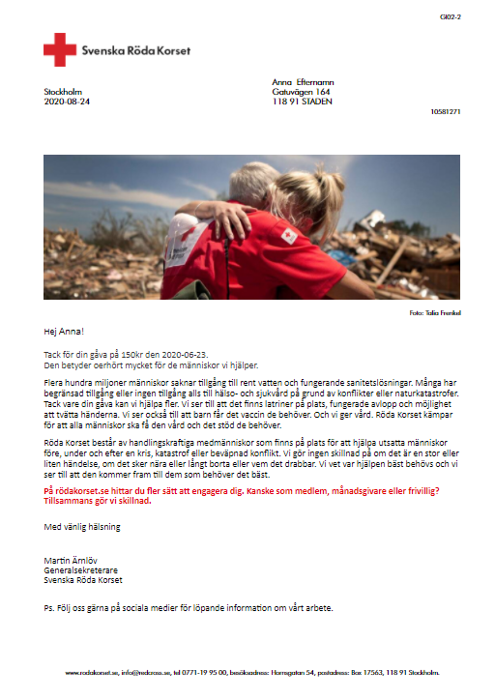
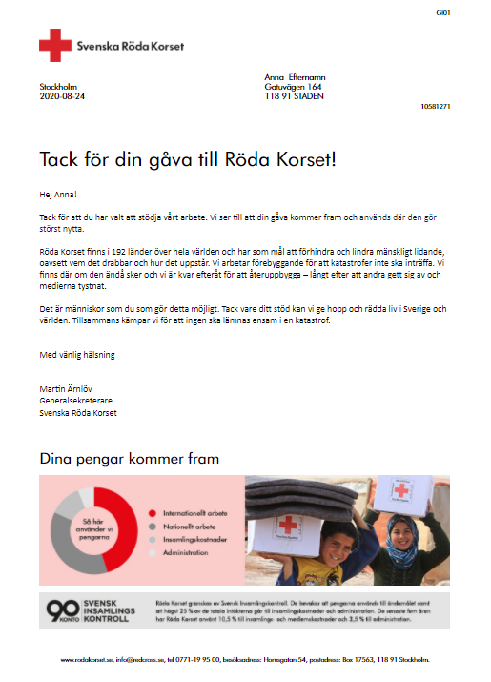
Say thanks in the right way – and channel
Direct mail based on Cause and New/Existing Donor
Conversion to Regular Donor +24%
Notes:
SMS as well, obviously email – dynamic messages – but same email and flow
Often changing the way of saying thanks – to stay fresh and that they learn something new every time
Direct mail based on Cause and New/existing donor
Direct mail max once a quarter – and only e.g. SEK 200+
Automated follow ups and reminders → +24% turn into regular donors
A true omnichannel approach gives better results (including direct mail and tele marketing) but has to be orchestrated centrally. (Important factors for donoation- timing but also to act on behaviour patterns regarding what channel the donor wants to receive communication and what channel the donor usually uses to donate- through the website, bank or swish for example.

Slide 10
Typical Charity Moments of Truth
Birthday – wish for donations
Change payment - PayPal to direct debit
Sign-up / one-off donation anniversary
Personalised appeal (Mosaic enhanced)
Tax refund automation
Become monthly donor
Credit card expiry
Gift aid reminder
Legacy
What was your money spent on?
NPS & refer-a-friend
Profile / family survey
Paid media exclusion / optimisation
Donation follow up – thank you
Pure / twin
acquisition
Welcome programme
Abandoned donation
Cancelled, still emailable
Volunteer instead of donating?
Permission
capture
Causes & Interests follow up
Payment failure
Re- permission
Notes:
This is the best practice for automated flows for Charities – Red Cross implementing all these over time will mean a lot of difference to a lot of people in need.

Slide 11
What makes Agillic special according to Röda Korset?
Easily orchestrate communication across channels
Easily coordinate Campaigns and Automated Communication
Easily reuse content (promotion / propositions)
Easy to act on behavioural data from the website
Biggest challenges:
Having fresh and engaging content
How to organise internally
Get the organization to know that MA is not about saving resources
Frida Wahlberg
CRM Analyst at Röda Korset
Notes:
Easily orchestrate across channels (email, sms, direct mail and paid media)
Easily coordinate Campaign Track and Automation Track (not list based – flows know about each other per default)
Reusable content (promotion / propositions - e.g. many ways of saying thanks)
Planned: Seems easy tot get behavioural data from the website and act upon it (who has visited the subscription page but not completed?)

Slide 12
Typical Retail Moments of Truth
Birthday / anniversary
Bargain hunter
Plan threshold
Related product / accessory
Share of wallet / cross category
New product model / collection
Local & personalised newsletter
Product replenishment
Local event
Purchase satisfaction
Out of stock / back in stock
Sample / transactional follow up
Store proximity
Profile / family survey
Refer-a-friend
Engagement through packaging
Permission capture
Category interest
Personalised newsletter
NPS
Win-back
Pure / twin acquisition
Welcome programme
Abandoned basket
Points / voucher expiry
Re-permission

Slide 13
Typical Subscription Moments of Truth
Birthday
Gift hunter
Anniversary
Related product / service
Share of wallet / cross-sell
New service/benefit
Credit card expiry
Dispatch notification
Plan check / switch
Subscription usage motivation / follow up
NPS & refer-a-friend
Profile / family survey
Plan renewal
Pure / twin
acquisition
Sign up
completion
Trial to paid
Cancelled, still using
Win-back
Permission
capture
Welcome programme
Payment failure
Re- permission

Slide 14
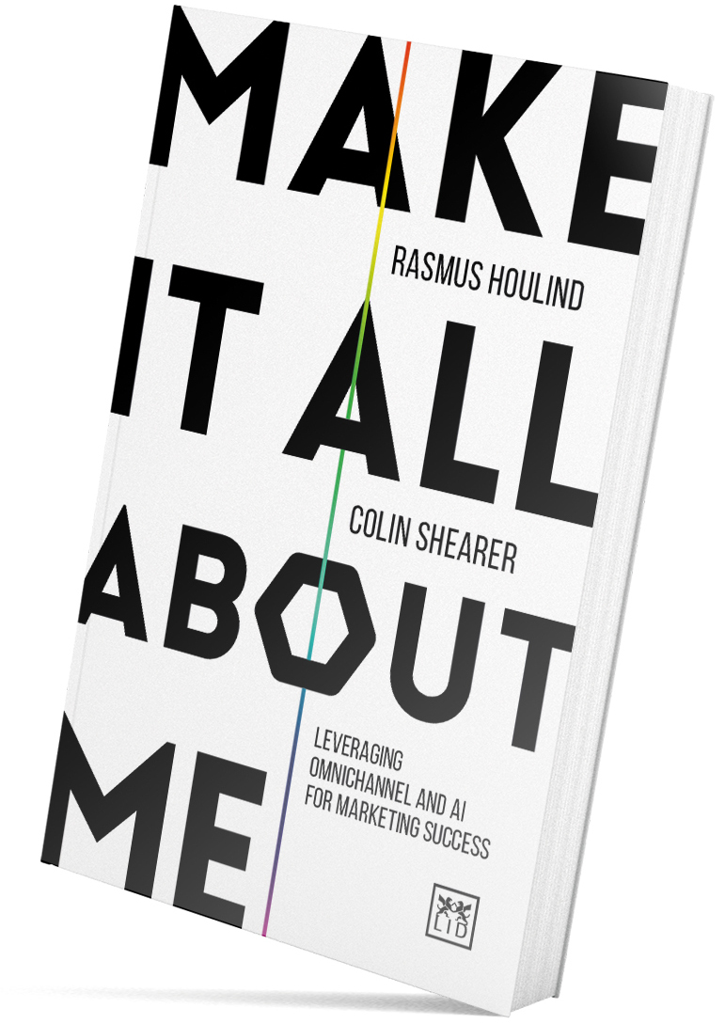
Questions?
Rasmus Houlind
Chief Experience Officer at Agillic
Author: ”Make it all about me” (2019)
Contact: Rasmus.Houlind@agillic.com
Frida Wahlberg
CRM Analyst at Röda Korset
Contact: Frida.Wahlberg@redcross.se
Agillic is a Marketing Automation platform enabling the use of data to always act on insight as you create, automate and execute hyper-personalised communication.
Born omnichannel, Agillic empowers clients to engage with prospects and customers across channels from a single interface. www.agillic.com

Slide 15
Thank you!
Rasmus Houlind
CXO at Agillic
rh@agillic.com

